Slide 1
Probability & Statistics Mini Project
Digital Learning Experience
PRESENTED BY
Ajmat Fatima
Harika Tirandas
Asiya Khan
Alisha Shaikh

Slide 2
OBJECTIVES
  To identify the different digital platforms used by students for learning, skill development, entertainment & personal interest.
  2. To identify the major challenges and barriers faced by students while using digital learning methods.
  3. To analyse the effectiveness of digital learning in improving student’s understanding & academic performance.
4. To examine student’s satisfaction & overall experience with digital learning.
2

Slide 3
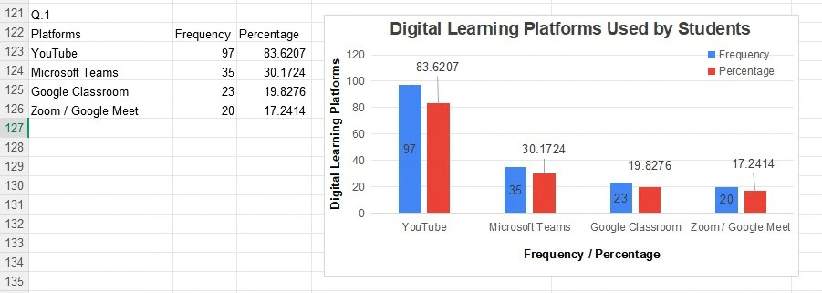
OBJECTIVE-1
1. Digital learning platforms used by students regularly.
INTERPRETATION
  YouTube shows the Highest preference among the surveyed students.
  Google Classroom and Zoom/Google Meet have comparatively low usage
  The result indicate that Students prefer easily accessible platforms like YouTube for digital learning.
3

Slide 4
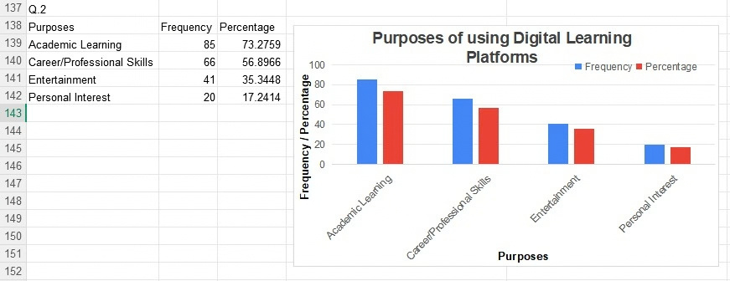
OBJECTIVE-1
  Mainly used digital learning platforms for by students.
INTERPRETATION
  Academic learning is the primary purpose for using digital learning platforms.
  Career and professional skill development is also a major purpose among students.
  Personal interest and entertainment have comparatively lower usage.
  Overall, the results indicate that students use digital platforms mainly for educational and skill-development purposes.
4

Slide 5
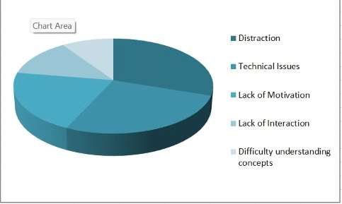
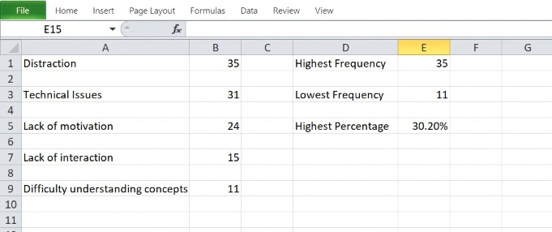
OBJECTIVE-2
  The biggest challenge that students face.
INTERPRETATION
  Distraction is the most reported challenge, closely
followed by internet & technical issues.
5
5

Slide 6
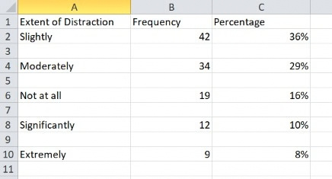
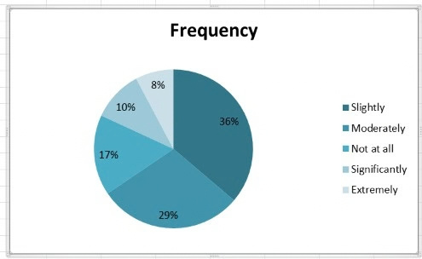
OBJECTIVE-2
  Effect of distractions on student’s concentration.
INTERPRETATION
  Most students experience distractions to at least to some extent.
6

Slide 7
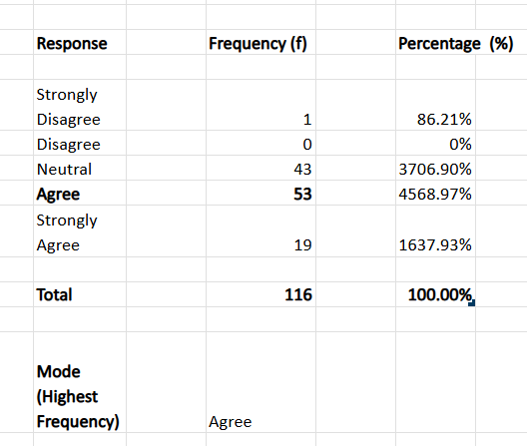
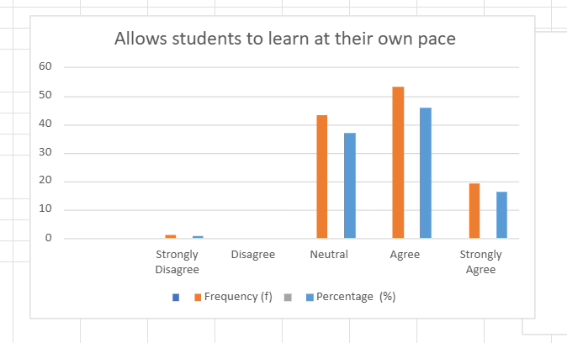
OBJECTIVE-3
  Digital learning allows to learn at student’s own pace.
.
INTERPRETATION
  The majority of students agreed that digital learning allows them to learn at their own pace.
  This indicates that digital learning provides flexibility and supports self-paced learning.
7

Slide 8
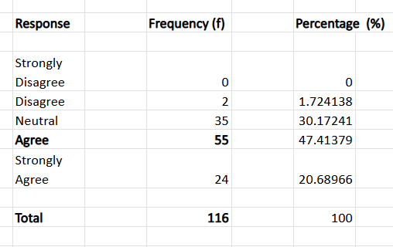
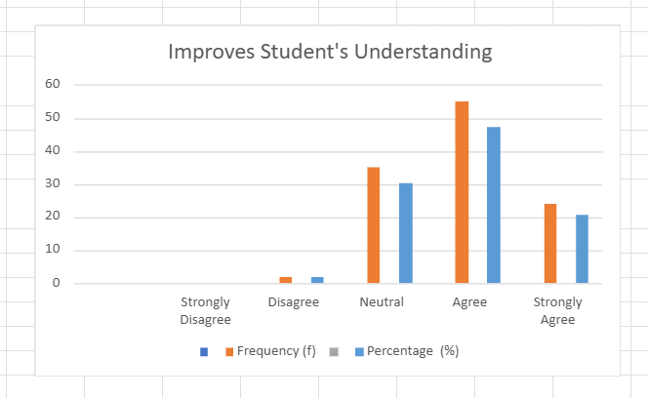
OBJECTIVE-3
  Digital learning improves student’s understanding of academic subjects.
INTERPRETATION
  The majority of students agreed that digital learning improves their understanding of academic subjects.
  This indicates that digital learning helps students understand and learn academic concepts more effectively.
8

Slide 9
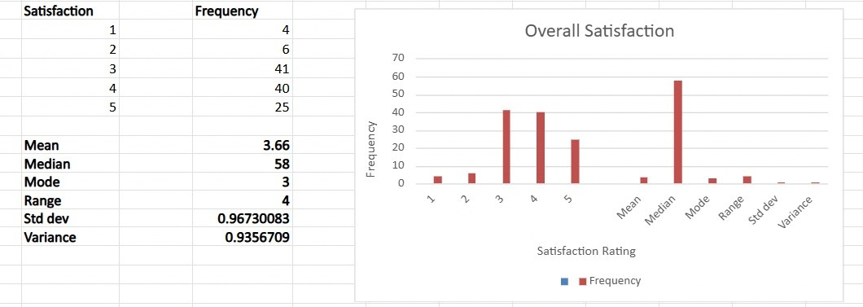
OBJECTIVE-4
  Overall digital learning experience satisfaction.
INTERPRETATION
  The average satisfaction score is 3.66 out of 5, indicating a generally
moderate-to-positive digital learning experience.
9

Slide 10
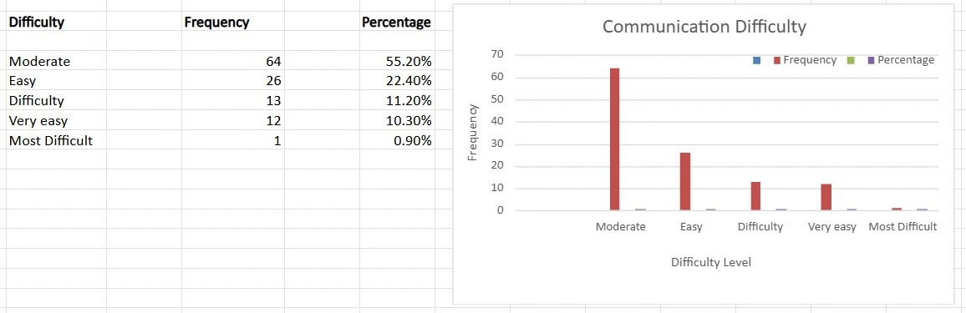
OBJECTIVE-4
  Difficultly to communicate with teachers & classmates.
INTERPRETATION
  More than half of the students reported moderate difficulty
in communicating with teachers and classmates during digital learning.
10

Slide 11
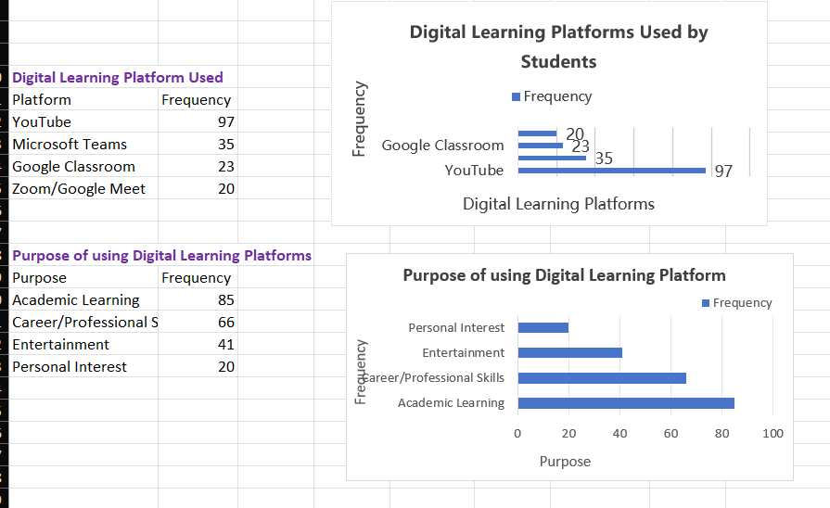
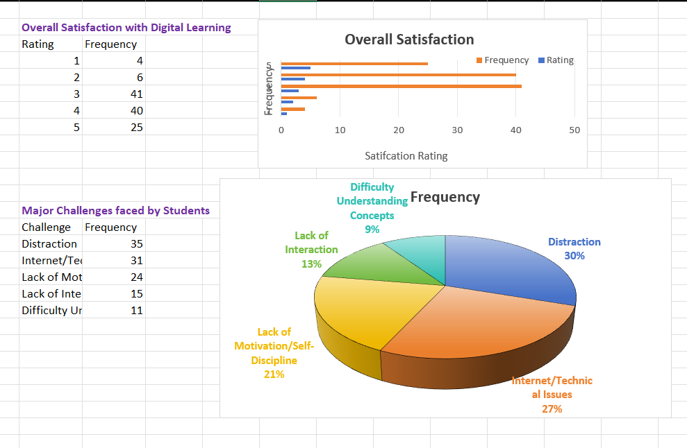
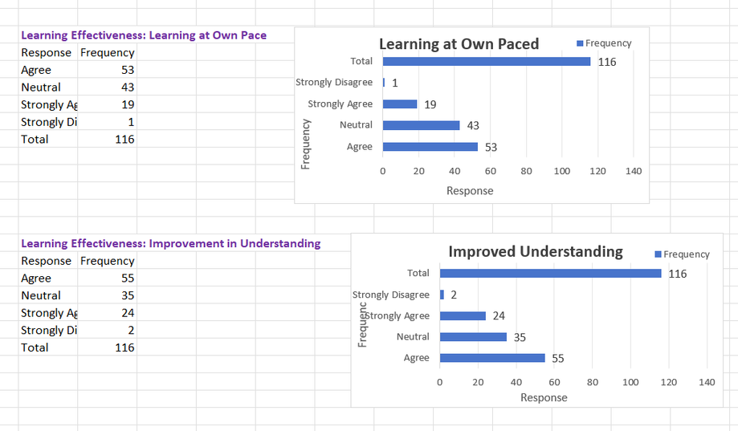
DASHBOARD
11

Slide 12
PROBABILITY & STATISTICS MINI PROJECT
Thank You.
PRESENTED BY
Ajmat Fatima
Harika Tirandas
Asiya Khan
Alisha Shaikh

